Slide 1
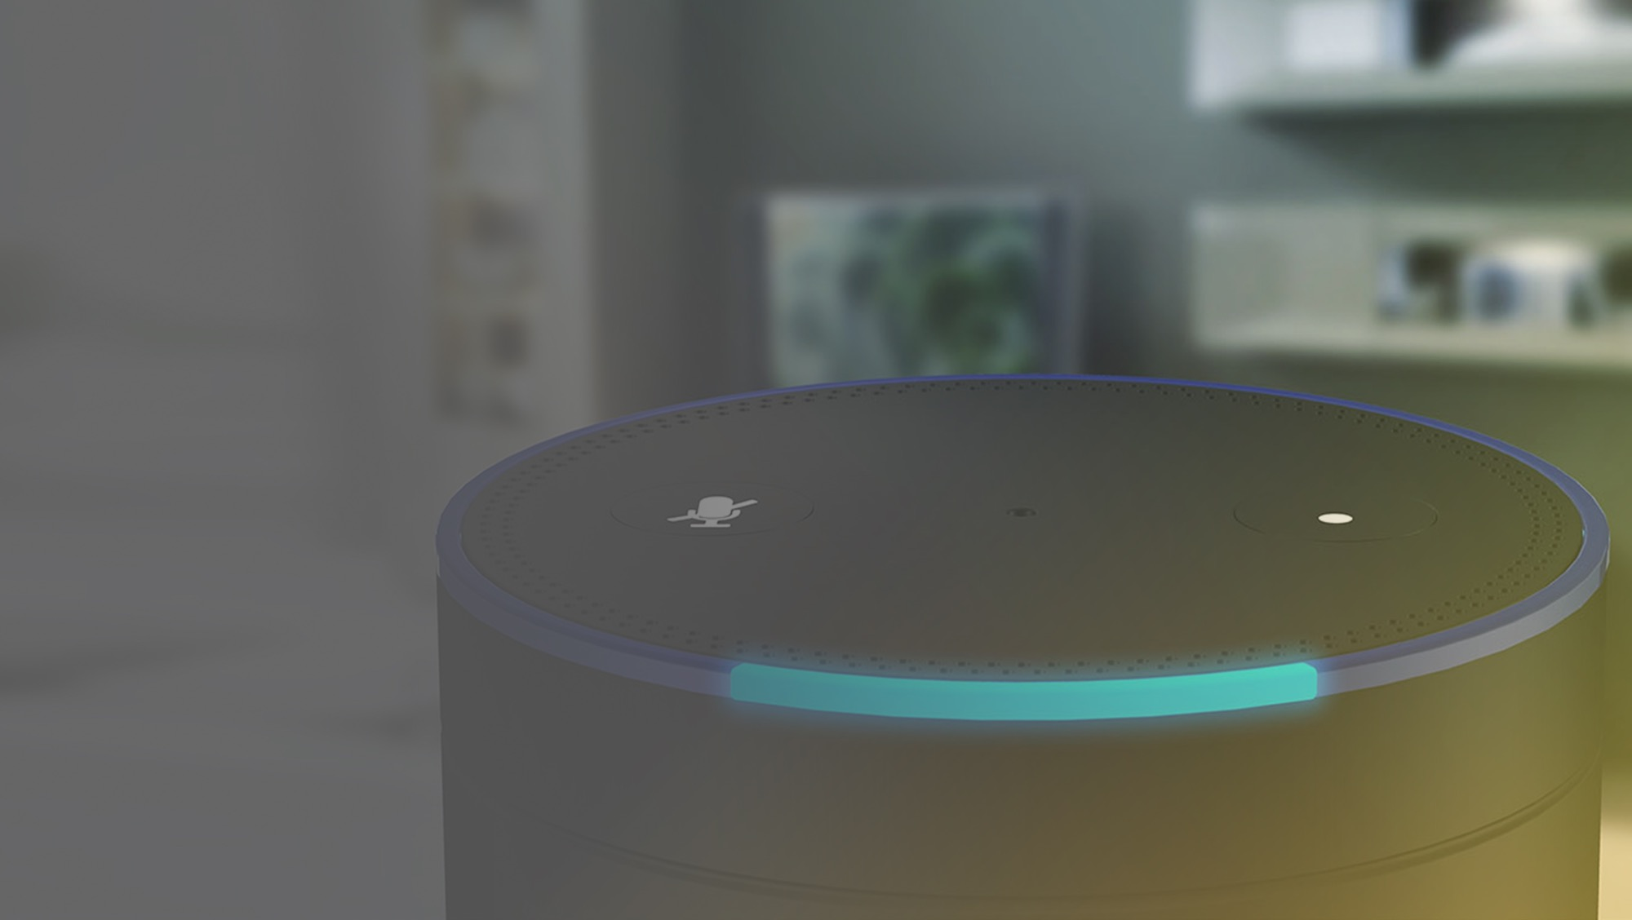
How to Automate Testing for Next Generation Interfaces (BOTs, Alexa, Mobile)
Andrew Morgan | Director of Product Marketing

Slide 2
Welcome
1
The Hyper Connected World
Past Apps vs Current Apps
Omni Channel Offerings by Enterprise
Channel | Mobile App
Mobile App Test Automation Challenges
Mobile App Testing Strategies
Channel | Bots
Nuances of Bot Testing
Automate Testing of Chat Bot
Automate Testing of Voice Bot
2
3

Slide 3
The Hyper Connected World

Slide 4
Past Apps vs Current Apps
Standalone App or Limited Connected App
Hyper Connected App
Connected via internet
Sensor data sync
Connected via internet
Smart Device sync
Camera Scanning

Slide 5
Omni Channel Offerings by Enterprises
Acme International
Mobile Apps
Web Presence
Smart Watch App
VR App
Bot
Smart TV App

Slide 6
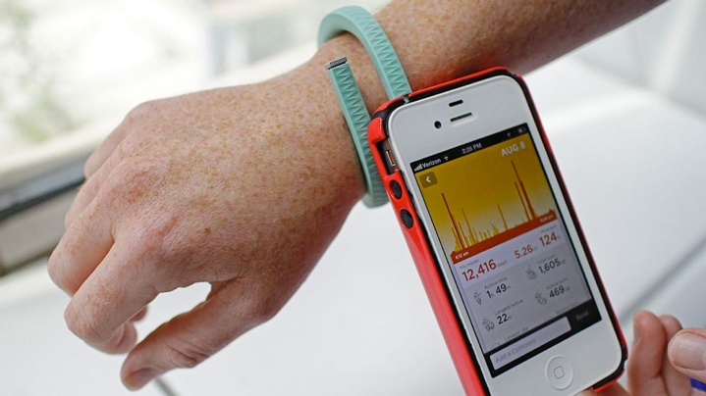
App Connected with BLE Smart Device
Peripheral Devices or Triggers
Syncing Data with BLE Smart Device
Connect, Disconnect, Broadcast, etc.
Sync Data
Determine certain actions
Image Source: http://a.abcnews.com/images/Technology/abc_jawbone_up_wristband_app_ll_130812_16x9_992.jpg

Slide 7
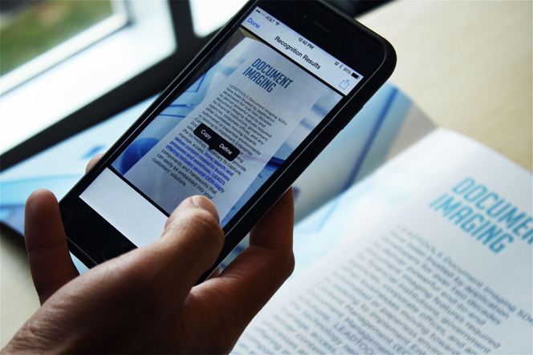
App extracting text from image
Peripheral Devices or Triggers
Using Mobile Camera Scanning Book
Intelligent Image Capturing Algorithm
OCR enabled
Image Source: https://www.leadtools.com/blog/wp-content/uploads/2017/06/mobile-ocr-app-in-action.jpg

Slide 8
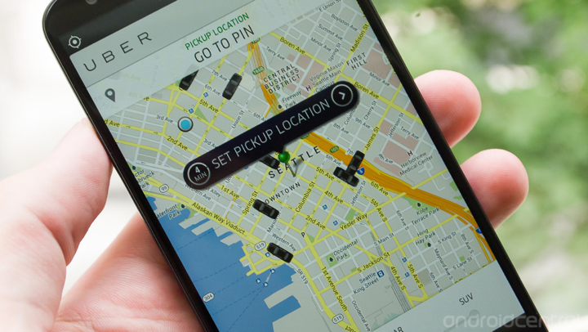
App Determining Location & Triggering Actions
Peripheral Devices or Triggers
Using Mobile Device Location
Current Location
Map rendering
Identify nearest object & notify (e.g. Cab)
Image Source: https://www.androidcentral.com/sites/androidcentral.com/files/styles/xlarge/public/postimages/444537/uber-app.jpg

Slide 9
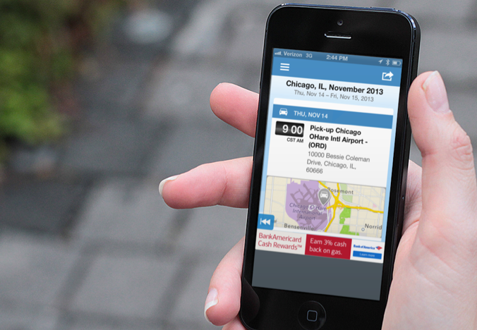
App Relying on Device Locale for Date & Time
Peripheral Devices or Triggers
Notifying Relevant Info to Customer
Get Device Local Date & Time
Determine and trigger notification for user’s action
Image Source: http://www.flightswatcher.com/wp-content/uploads/2017/08/tripit-user.png

Slide 10
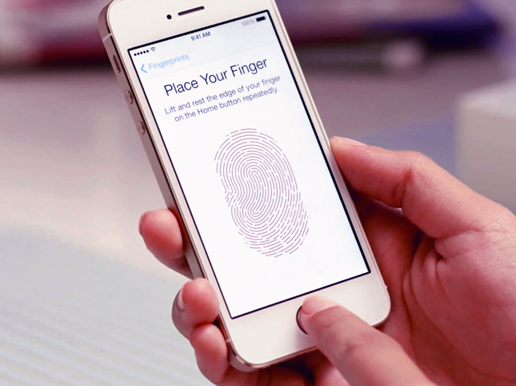
App Relying on Biometric Authentication
Peripheral Devices or Triggers
Authenticate User & Provide Info
Fingerprint Scanning
Authenticate & Trigger Action
Image Source: https://www.imore.com/sites/imore.com/files/styles/larger/public/field/image/2013/09/iphone_5s_touch_id_fingerprint_video_hero_4x3.jpg?itok=bhma0a7k

Slide 11
Mobile App Test Automation Challenges
Existing popular tools like Appium do not support automation of device hardware testing (Camera, TouchID)
Hardware level access for automation necessitates the need for code level instrumentation
Testing use cases around interruptions are important but complex.

Slide 12
Automation Library Approach
Command Handling & Processing
Automation Features
Mobile Automation Library Interface
Touch ID
Apple Pay
REST Web Services
Camera
GPS
Date Time
BLE
Web Socket Listener
Accelerometer
Gyroscope

Slide 13
Automation Approach
App Binary
CI Server
Mobile Device Cloud
Instrumented App Binary
Automation Config
Commands from Automation Script

Slide 14
Use Case: Automate the testing of location
A field staff needs to initiate the job that is assigned to him
Condition is – person can initiate only if he is actually at that location
Manual approach is costlier
Traditional approaches can’t spoof the location
Using Infostretch’s Mobile Automation Framework, we can spoof the location based on test data and can verify the scenario in less than 20 secs

Slide 15
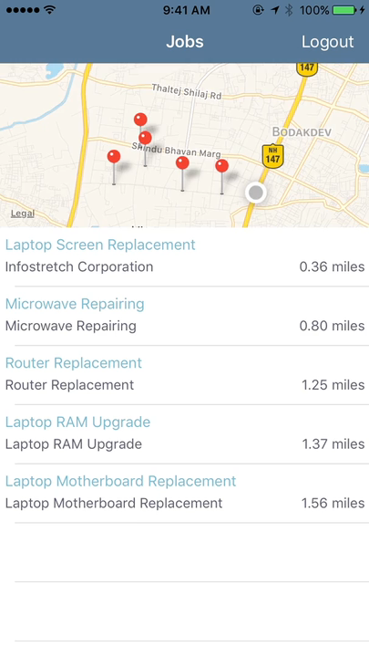
Demo

Slide 16
Channel | Bots

Slide 17
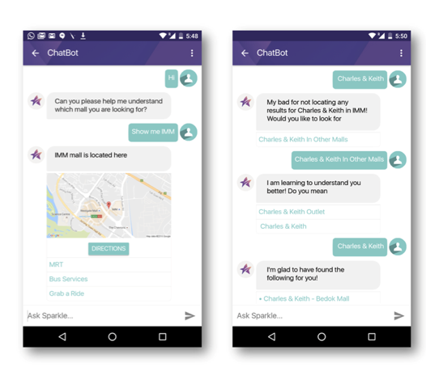
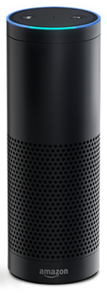
Types of Bots
Tell Reception Bot, Acme International team is here
Welcome to Infostretch Corporation. Hope you had a pleasant drive.
Image Source: https://ncmedia.azureedge.net/ncmedia/2017/11/app-1.png
Chat Bot
Voice Bot

Slide 18
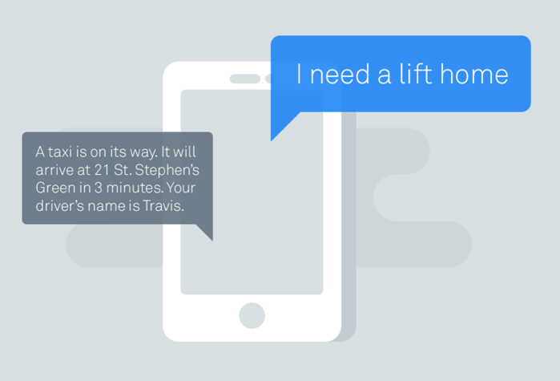
Conversational UI
Big shift happening in the industry for the conversational interfaces or Zero UI interfaces.
Need different approach to test Non-UI elements
Image Source: https://www.gupshup.io/developer/resources/img/marketecture/comprehensive-integrated-framework.png

Slide 19
Nuances of Bot Testing
Common Factors
Specific Factors
Ident Validation
Specific Factors of Chatbot
Response Validation
Specific Factors of Voicebot

Slide 20
User’s Intent Validation
1
Who won the Super Bowl last year?
User’s Intent
User types something or speaks something
Bot understands it
Called as User’s Intent Understanding
Intent: Know Winning Team
Team: Winning Game: Super Bowl Year: 2016

Slide 21
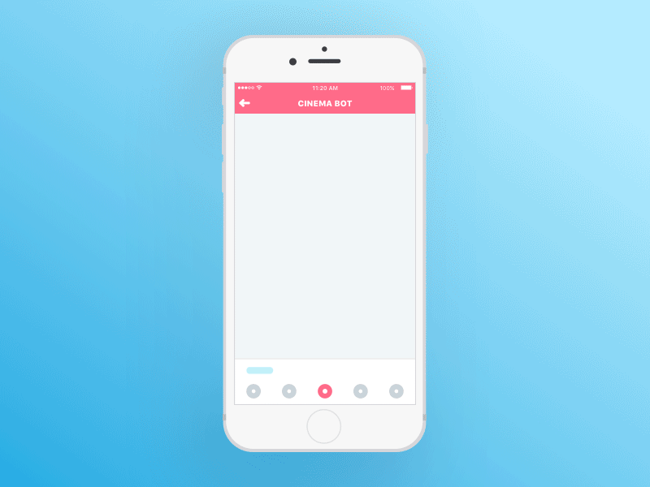
Bot’s Response Validation
2
Bot’s Response
Based on Intent understanding, bot can:
- Either call specific web service, or
- Reply based on intelligence embedded in the bot itself
Without user’s entry, bot can push information (e.g. Weather updates)
Image Source: https://s-media-cache-ak0.pinimg.com/originals/58/31/1e/58311e3f691d9b4efd5e4d3d96f846b9.gif

Slide 22
Factors to be tested for Chatbot
Different Response – Same Query
Response time from bot
Smart bots would react differently to the same query. When a user mentions “thanks” it would reply as – “Welcome” or “My Pleasure” or “No problem”
How much time your bot is taking to respond back to your user’s queries. Timeout defined for the bot response must also be aligned to that during automation
Bot’s understanding of intents
Multiple Queries in single sentence
Different users asks the same query in different ways. User 1 asks – “Growth of my portfolio” User 2 asks “percentage change in my portfolio”
How does your bot handles the multiple queries in single statement? User asks – Show me the suspicious transactions value and total loss in 2017
Typo Errors Understanding
Mixed Languages Query
How far a bot can understand the the typo error from a user without polluting with other intent.
Can your bot understand the multiple languages that has been asked? User may write - Combien avez-vous facturé pour mon POS system?

Slide 23
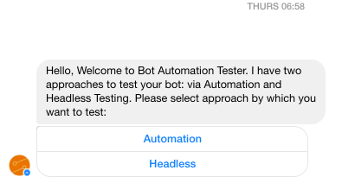
Approaches
Automation Testing of Bot
Imitating User’s Action
Headless Testing
Imitating User’s Action
Headless Testing
Infostretch’s Automation bot testing the “bot under Test”

Slide 24
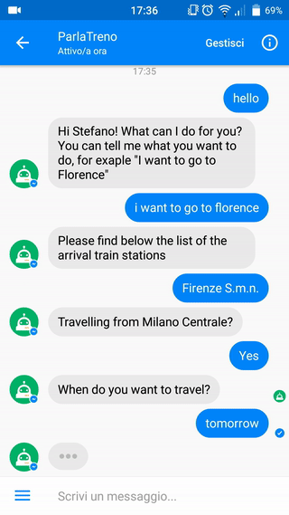
Imitating User’s Action - Approach
1
Upload Test Data using Excel/CSV
Infostretch Framework allows to test the bot’s flow end-to-end per Test Scenario
It imitates user’s action and interacts with bot
Captures the response of the bot and compares with the response data mentioned in Test Data Excel/CSV
Imitating User’s Actions

Slide 25
Headless Testing - Approach
2
Upload Test Data using Excel/CSV
Infostretch Framework spoofs and directly connects to bot server of “Bot under Test”
User’s actions are sent directly bypassing the bot channel
Captures the response of the bot and compares with the response data mentioned in Test Data excel/CSV
Headless Testing

Slide 26
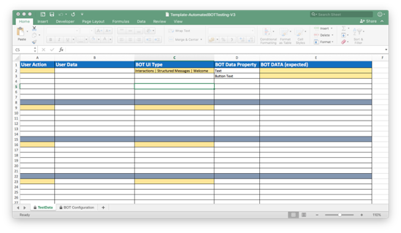
Test Data Options
Upload Test Data using Excel/CSV
Upload Test Data using Excel/CSV
Create specific format from Mind Map diagram and push into bot Automation Framework
It helps in reducing the maintenance time by managing the requirement changes in mind map itself

Slide 27
Automated Testing of Voicebot

Slide 28
Factors to be Tested for Voicebot
Different accents, gender
Punctuations
How does bot behaves for different accents & gender combinations - American female, British Male
How bot interprets the punctuations:
Tools, without any, skill is helpless – vs -
Tools, without any skill is helpless ?
Same meaning different utterance
Background Noise
Yes, yeah, true, exactly, certainly, etc. can be used interchangeably. Bot must understand them.
Check for the effect of noise on the bot’s capability to understand user’s intent.
Different pronounciations
User speaking at distance
People often pronounce assessory instead of accessory – does your bot understands the essence of user’s intention?
Effect of user speaking from distance, or in case of listening device being stationary (e.g. Echo) and user is moving and speaking – how does that impact bot’s behavior?

Slide 29
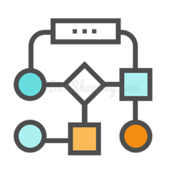
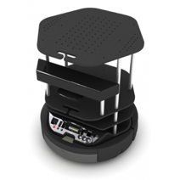
Approach
Intent Testing
Test Suite with Test cases running in sequence
Utterances as input
(pre-recorded/run-time generated using third-party TTS API)
Change distance using Turtlebot, add Noise, etc.
Ask Automation Bot, Run Test Suite for Diagnosis

Slide 30
Thank You
Connect With Us
info@infostretch.com
+1-408-727-1100

